Slide 1
Case Studies for Developing Transit Asset Management Plans
Charlie Sullivan, AICP
June 3, 2019

Slide 2
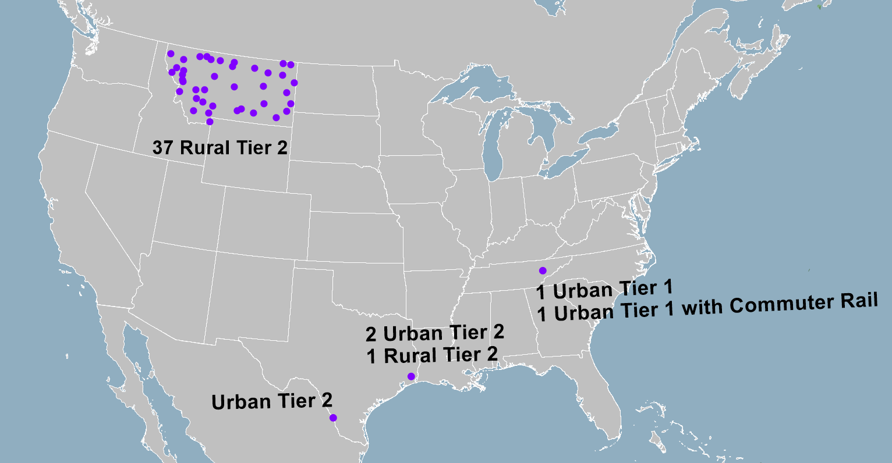
Different Types and Contexts of TAMPs
Montana
Laredo
Beaumont
Nashville
Notes:
Transit Asset Management Plans are a new FTA requirement, but we have completed assisting varied transit agencies throughout the country with a group TAMP , urban, rural, Tier 1, and Tier 2 requirements.

Slide 3
Key Commonalities and Findings
They all already did asset management. The TAMP is a new planning program intended to make the process more strategic and more systematic.
FTA provides guidance and tools…..and deadlines.
Even though it’s a new Federal program, it’s still a good idea.
Notes:
Though the TAMP requirements vary by context, we found common elements and findings for all our TAMPS.

Slide 4
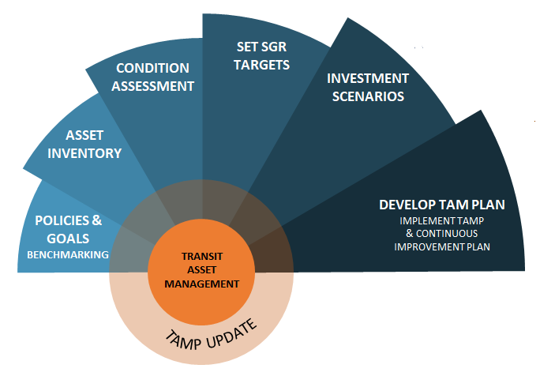
The TAMP Program
What have I got?
What condition are they in?
What is my target?
With the Budget I have….
What can I do about it?
In what order?
Notes:
As a review, the core FTA requirements can be summarized into six logical steps.

Slide 5
What did we Learn From These TAMPS?
Data!
There are two kinds of people in the world:
Those who can extrapolate from incomplete data,
Organization!
It is no longer sufficient that we do our best….we must do what is necessary.
- Winston Churchill
Notes:
The key points that we learned are necessary relate to data and organization.

Slide 6
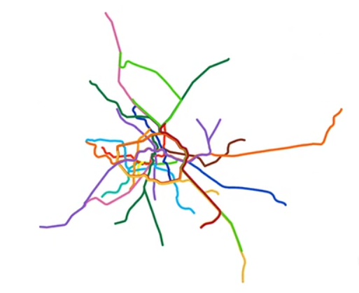
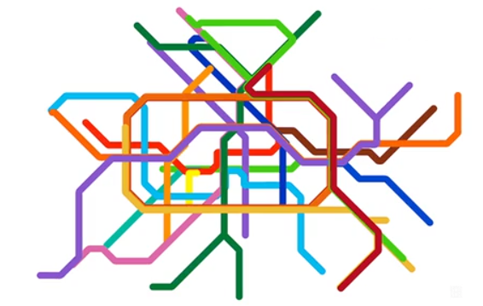
Data
Format is as important as the data itself.
Consistency drives efficiency and effective use.
Notes:
Two iterations of the rail map for Berlin show the importance of data formatting. Simply having the data available is not sufficient, it has to be orderly to be understood. Further, it has to be able to relate to other data in order to be useful.

Slide 7
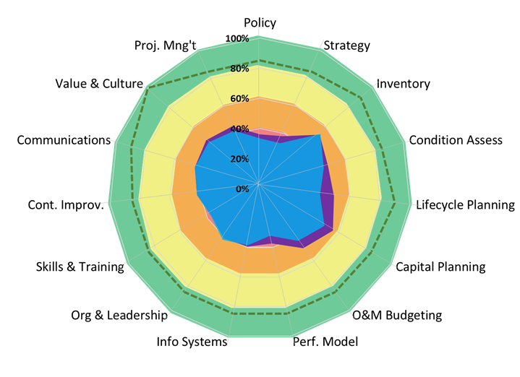
Organization
Agency 1
Agency 2
Developing order and a common framework for existing systems is unexpectedly complex, with many independent systems that work just fine on their own…but not together.
Notes:
We found data was typically collected within departments very well, according to their own standards. We also found that the departments could often not communicate with other departments, and had different data definitions and timelines when they did. This sometimes made worthwhile programs impossible to implement because they could not gather the data to define the need or benefits.

Slide 8
Organization
Where you are today
Where you want to be
What gaps between the two
Implementation Roadmap
The TAMP itself is work but it’s straightforward.
The first iteration can require heroic efforts from key people.
The issue is to develop a sustainable program that can be implemented well, with reasonable efforts. That implementation is even harder, and is less straightforward.
The key constraint is that the most vital people to implementation are the supervisors; not the workers.
Notes:
All over the country we found great, committed professionals who put in extra effort to implement their first TAMP. That kind of effort is simply not sustainable, and the work will ultimately outweigh the benefits. That misses the potential of the whole TAMP program.

Slide 9
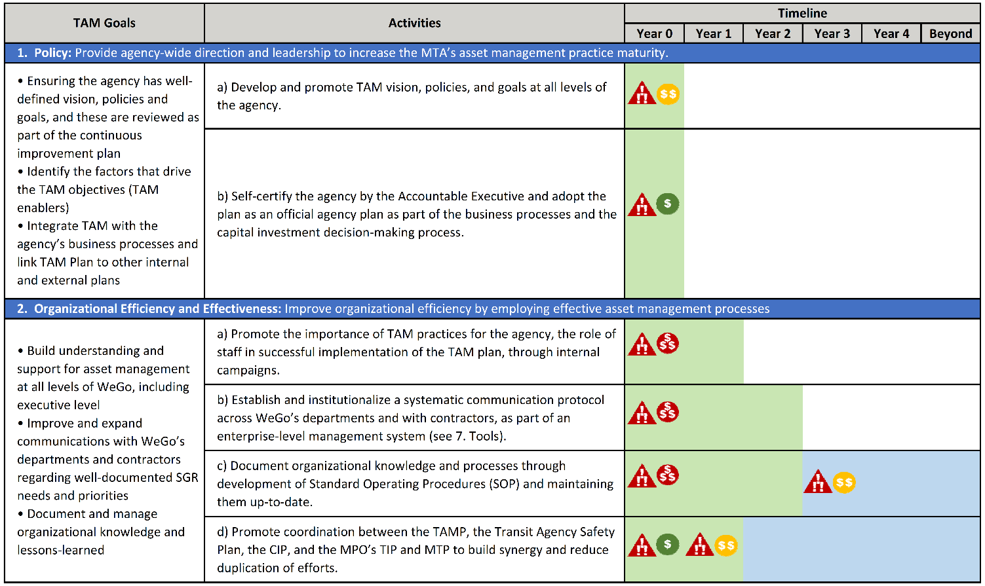
Implementation Roadmap
Notes:
Even for the smaller or more simple systems, some sort of an implementation roadmap is necessary to guide the agency in the data and organization efforts to build an efficient and effective program.

Slide 10
Summary
Coordination requires data and data management.
Collecting and managing data is a burden.
An effective TAMP makes the burden worth while.
You can do anything once through heroic efforts. Sustaining the task requires organization and commitment.

Slide 11
Thank you!

